Slide 1
Compression Neural Nets
Under the guidance of,
Dr. Animesh Chaturvedi

Slide 2
Team Members
19bcs035 - Dasari Rishikesh
19bcs068 - Mathangi Sravan
19bcs101 - Sompalli Ajay kumar

Slide 3
Table of contents
Introduction or overview
Motivation
Problem Statement
Literature review
Methodology
Datasets
Knowledge distillation
Mathematical Intuition
Results
Conclusion

Slide 4
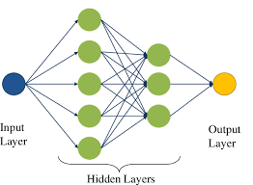
Overview
Deep Neural Networks has achieved great success in
Computer vision tasks.
It is generally optimised to get more accurate results.
DNN have huge number of parameters sometimes in order of millions.

Slide 5
Motivation
DNN are computationally expensive and memory intensive.
The Deep Neural Network uses the high end GPUs and powerful processors.
It is necessary for the devices like mobiles, UAVs(Unmanned Aerial Vehicles ) and IoT devices needed for better privacy, less network bandwidth and real time processing.
So goal to perform model compression and acceleration.

Slide 6
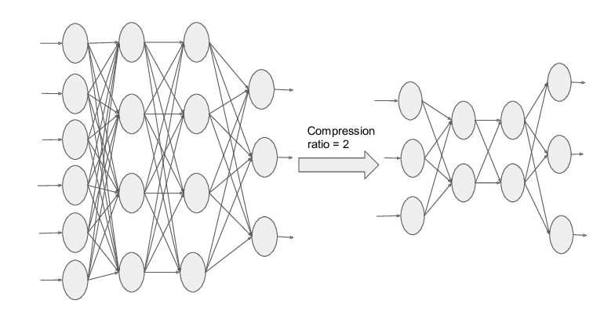
Problem Statement
Reduce the storage and energy required to run the interface of large networks so that they can be deployed on the portable devices with limited hardware resources.

Slide 7
Literature Review
Compression with Pruning , Trained Quantization and Huffman coding by Song Han(Conference at ICLR, 2016)
Knowledge distillation : A good teacher is patient and consistent by Lucas Beyer(CVPR, 2022)
A Survey of Model Compression and Acceleration for Deep Neural Networks by Yu Cheng (IEEE, 2020)
Combining Weight pruning and Knowledge distillation for CNN Compression by Nima Aghli (CVPR, 2021)

Slide 8
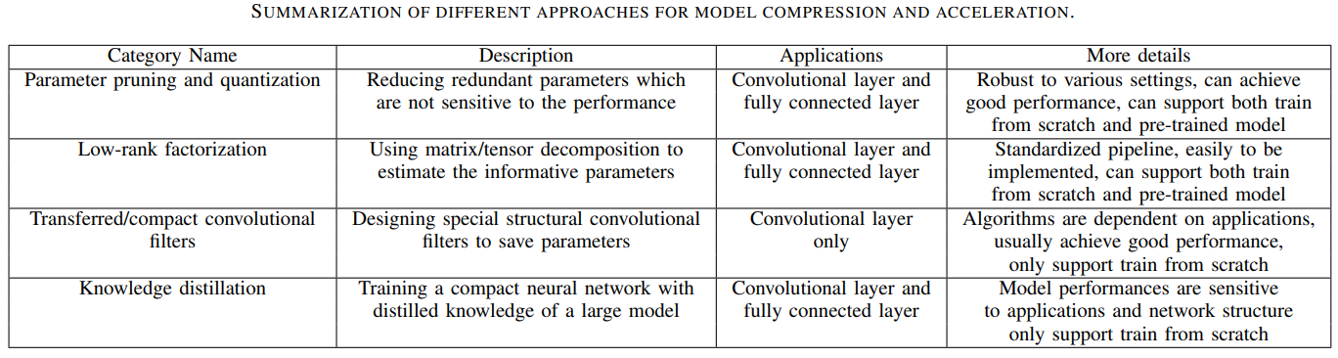
Categories

Slide 9
Methodology
Initial approach with the parameter pruning and quantisation.
Flaws exist when comes to complex architecture i.e., Residual Network models.
Compression models doesn’t support change of model family and exist architecture-dependent challenges.

Slide 10
Deployed Environment:
Colab
TensorFlow
Datasets:
MNIST
CIFAR -10
Flowers 102
Network Architectures:
Convolution Neural Network
Residual Network

Slide 11
Knowledge distillation
Knowledge distillation is technique of transferring knowledge from the larger into smaller models.
The models are larger model are known as teacher and student model as student model.
The compression model minimizes the loss function (distillation loss) and aimed at the matching the teacher logits as well as ground- truth labels.
The logits are softened by applying a “temperature “ scaling function in the softmax, effectively smoothing out the probability distribution and revealing inter class relationships by teacher.

Slide 12
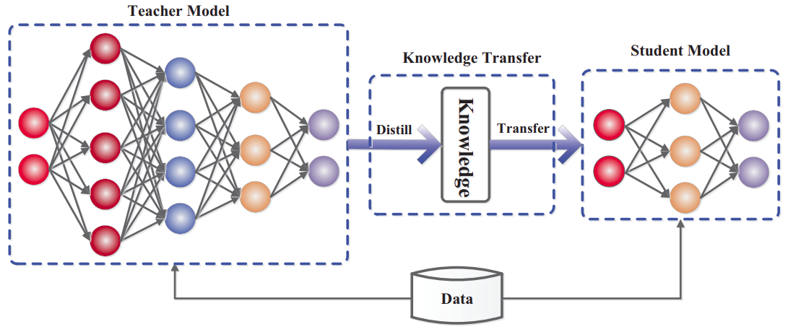
Illustration of KD
Ref: Knowledge Distillation: Principles, Algorithms, Applications - neptune.ai

Slide 13
Function Matching KD
In, Function Matching, distillation approach yields student models that can actually match the performances of teacher models.
The hypothesis has mainly three key takeaways:
No use of ground-truth labels during the distillation process.
Teacher and student should see the same input image views, i.e., same crop and augmentations.

Slide 14
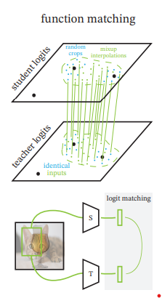
Function Matching continued…
The functions to match on a large number of support points to generalize
them.
Aggressive form of MixUp as the key augmentation recipe. The mix up is
paired with “Inception style ” cropping.
Long training schedules for distillation.
Ref: Knowledge distillation : A good teacher is patient and consistent by Lucas Beyer(CVPR, 2022)

Slide 15
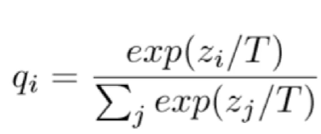

Mathematical Interpretation
Softmax function:
Loss 1(soft targets) = Cross Entropy(teacher_pred, student_pred)
Loss 2(Hard targets) = Cross Entropy(student_hardpred, hard labels)
Loss =
Function Matching:
Ref : https://www.youtube.com/watch?v=gADXP5daZeM
Ref: Knowledge distillation : A good teacher is patient and consistent by Lucas Beyer(CVPR, 2022)

Slide 16
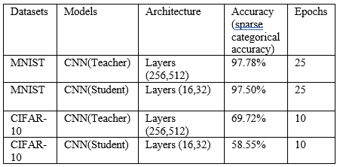
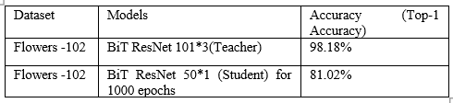
Results
Knowledge distillation on MNIST Dataset
Knowledge distillation using function matching hypothesis on Flowers-102 dataset

Slide 17
Conclusion
In this project we have analysed application of compression models on different Network architectures. While using different models, we observed that the Pruning does not go well for all architectures, as because it changes the shapes of input in the architecture. Whereas Knowledge Distillation can be easily applied for different architectures without losing information. It provides close accuracy with the original model.

Slide 18
References
[1] Song Han, Huizi Mao, William J. Dally, “Deep Compression: Compression Deep Neural Networks with pruning, Trained quantization and Huffman coding”, Conference at ICLR 2016
[2] Lucas Beyer, Xiaohua Zhai, Amelie Royer, Larisa Markeeva, “Knowledge distillation: A good teacher is patient and consistent”, CVPR 2022.
[3] J. Ba and R. Caruana, “Do deep nets really need to be deep?” in Advances in Neural Information Processing Systems 27: Annual Conference on Neural Information Processing Systems 2014, December 8-13 2014, Montreal, Quebec, Canada, 2014, pp. 2654-2662.
[4] Nima Aghli, Eraldo Ribeiro, “Combining Weight Pruning and knowledge Distillation for CNN compression”, CVPR 2021.
[5] Yu Cheng, Duo Wang, Pan Zhou, “A survey of Model Compression and Acceleration for Deep Neural Networks”, IEEE signal processing Magazine.

Slide 19
Thank You

